Slide 1
Introduction to Operating System
Cherry Khosla

Slide 2
Introduction
In any computer system we have user applications, system programs, and hardware.
Each of these components holds a key role in the flow of the system.
Where does an operating systems fits in all these building blocks of
a system?
An operating system acts as an intermediatory between user and hardware.
It also acts as a resource manager (Hardware and software both)

Slide 3

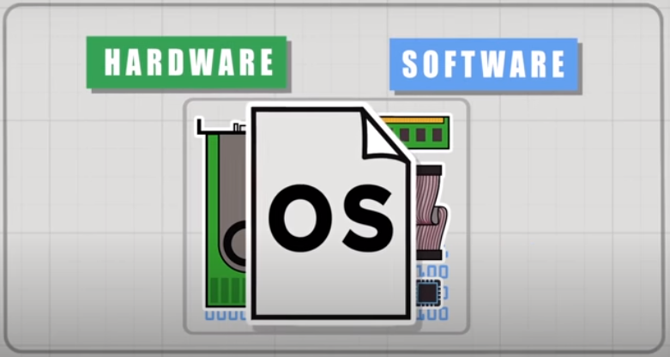

Slide 4
Why do we need Operating System
Can a user process directly access hardware in the system? Is it
necessary to use OS as an intermediatory between hardware and
user?
User processes can access hardware directly, but doing so is neither convenient nor efficient
  Reasons:
  Security For example, if processes could directly access a disk, they can bypass filesystem permissions. If applications could directly access physical memory, they can read other process's data.
  Management of resources in multitasking environment

Slide 5
Goals and Functions of Operating system
GOALS
Primary Goal
  Convenience/User Friendly
Secondary Goal
  Efficiency
FUNCTIONS
Process Management
Memory Management
I/O device Management
File Management
Security and Protection

Slide 6
Do we have operating systems just for PC’s?
We have discussed here different machines where operating system is in use apart from laptops and desktops

Slide 7
Types of Operating System
Batch Processing Operating system
Multi Programming
Multi Tasking/Time Sharing
Multi Processor
Real Time OS

Slide 8
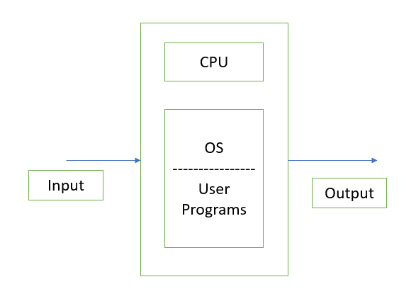
Earlier Mainframe Systems
The computer is mainly comprised of two things: memory and CPU. The CPU was used to be very simple processing unit capable of doing simple calculations and a very limited amount of memory. The memory was not bifurcated into different categories( Cache, secondary) like we have nowadays.
In earlier mainframes systems:
  Common input and output devices were card
  readers and tape drives.
  User prepares a job which
  consists of program, i/p and control instructions.
  Input job is given in terms of punch cards and
  output is also appear in terms of punch cards

Slide 9
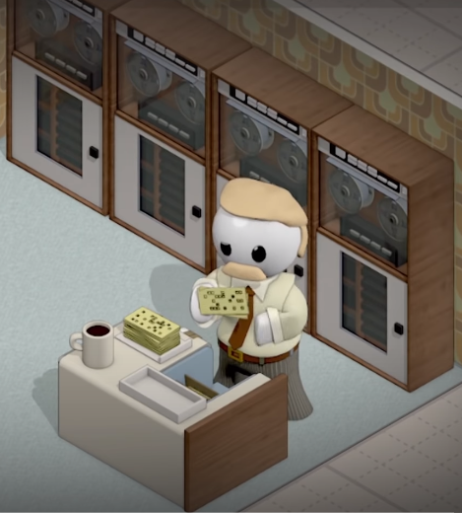
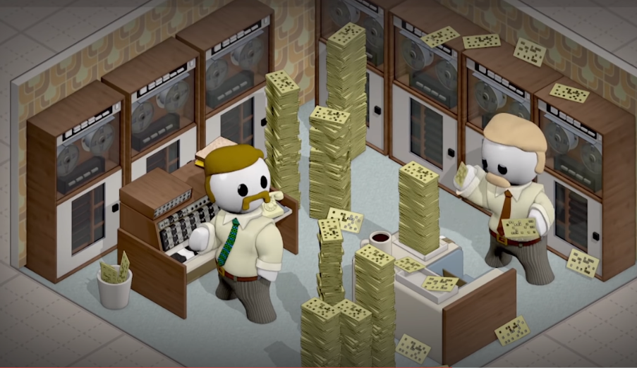
Batch Processing Operating System
Because of poor disadvantages of mainframe systems, there arises need of batch processing operating systems
Where jobs with similar needs are batched together and executed by the processor in groups

Slide 10
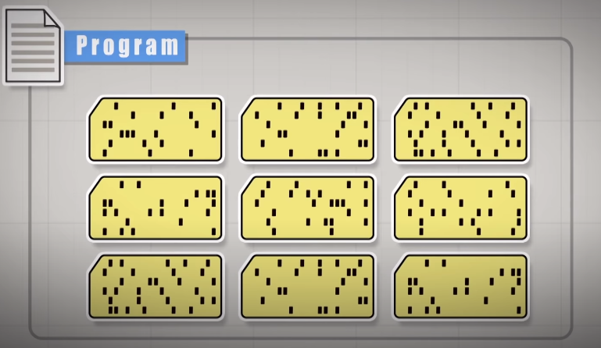
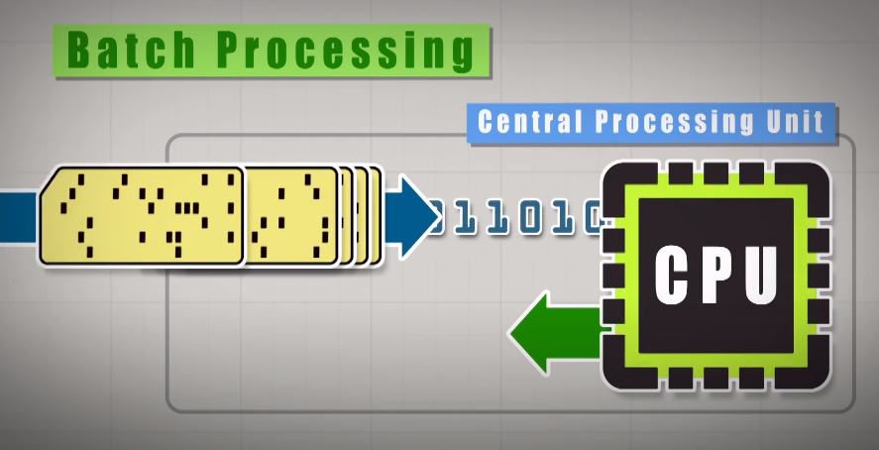
Batch Processing OS
Operator sorts the jobs and prepares a batch of punch cards with similar needs
Programs were written on punch cards
punch cards were fed into system for processing
SPOOLING: Simultaneous peripheral operations on-line is a concept used in batch processing OS where Spooling works like a typical request queue where data, instructions and processes from multiple sources are accumulated for execution later on.

Slide 11
Multi Programming OS
It means more than one process are in main memory which are ready to execute.
Process generally requires
CPU time and I/O time.
Maximum CPU Utilization.
Secondary Memory
Main Memory
OS
P1
CPU
P2
……
Pn

Slide 12
Multi-tasking/Time Sharing OS
It is multiprogramming with time sharing
Only one CPU and switching between processes occurs so quickly thereby creating an illusion that more than one task is going on at one time
The tasks in multitasking may refer to multiple threads of the same process.
Each Process/task/threads gets a fair share of CPU time.

Slide 13
Question
Multiprogramming is…………………….
Executes more than one process at the same time
Keeping more than one programs in the main memory which are ready to execute

Slide 14
Question
Which special concept is added to batch processing OS which makes use of disk to queue the jobs
Main frame systems
SPOOLING
Multiprogramming

Slide 15
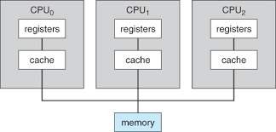
Multi Processor OS
More than one CPU’s in a single system in close communication sharing the system bus, memory and other I/O devices.
Different processes may run on different CPU’s
Types
  Symmetric- One OS controls all CPU, each CPU has equal rights
  Asymmetric-Master slave architecture

Slide 16
Real Time OS
Special-purpose operating system
A real time operating system is used when rigid time requirements have been placed on the operations of the processor, data flow
A real time systems have well defined, fixed time constraints.
Hard Real time systems
Soft Real time systems
Examples of RTOS: Google Brillo, QNX, Integrity etc.

